Slide 1

Consumer Goods
Ad_Hoc_Insights
Presented by : Shaikh Mohammad Abu Tahir

Slide 2
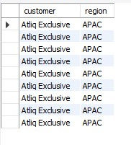
1. Provide the list of markets in which customer "Atliq Exclusive" operates its business in the APAC region.
Insights :
Focus on a specific customer ("Atliq Exclusive").
Targets the APAC region.
Enables detailed performance analysis.
Informs strategic marketing and service decisions.
Allows for comparison with other customers in the region.

Slide 3
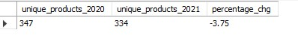
2. What is the percentage of unique product increase in 2021 vs. 2020? The final output contains these fields, unique_products_2020 unique_products_2021 percentage_chg.
Insights:
Measures growth in unique products from 2020 to 2021.
Identifies trends in product diversity over two years.
Helps assess market expansion or contraction.
Informs inventory and product strategy.
Provides data for performance evaluation and forecasting.

Slide 4
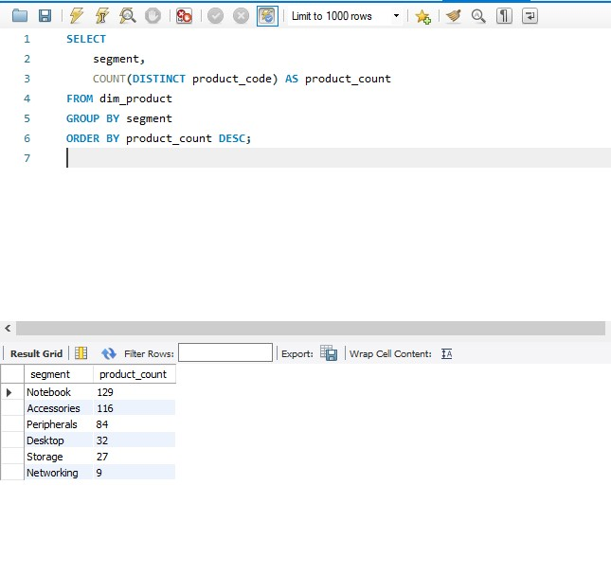
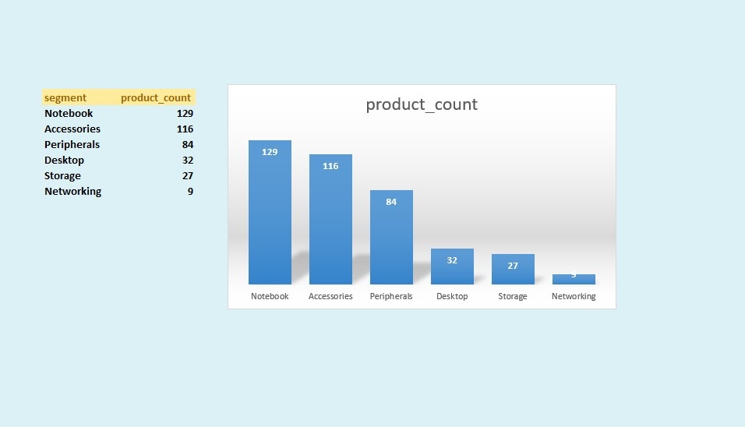
3. Provide a report with all the unique product counts for each segment and sort them in descending order of product counts. The final output contains 2 fields, segment product_count.
Insights on Unique Product Counts by Segment
Highlights product distribution across different segments.
Identifies which segments have the highest product variety.
Assists in understanding market focus areas.
Informs product development and marketing strategies.
Helps prioritize segments for sales efforts.

Slide 5
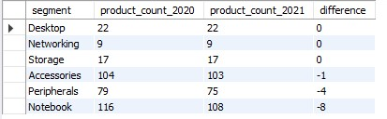
4. Follow-up: Which segment had the most increase in unique products in 2021 vs 2020? The final output contains these fields, segment product_count_2020 product_count_2021 difference.
Segment Increase in Unique Products
Identifies the segment with the highest growth in unique products.
Highlights market trends and consumer demand shifts.
Informs strategic decisions for product allocation and marketing.
Assists in evaluating segment performance year-over-year.
Aids in targeting specific segments for future development efforts.

Slide 6
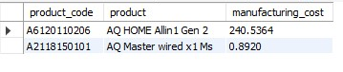
5. Get the products that have the highest and lowest manufacturing costs. The final output should contain these fields, product_code product manufacturing_cost.
Insight:
Provides a benchmark for assessing manufacturing efficiency across products.
Highlights potential pricing strategy adjustments based on cost structures.
Identifies high-cost products that may need redesign or sourcing reevaluation.
Supports financial forecasting and budget planning for production.
Enables comparison with industry standards to assess competitiveness.

Slide 7
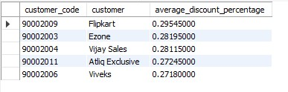
6. Generate a report which contains the top 5 customers who received an average high pre_invoice_discount_pct for the fiscal year 2021 and in the Indian market. The final output contains these fields, customer_code, customer, average_discount_percentage.
Insights:
Identifies customers benefiting the most from discounts, indicating loyalty or negotiation power.
Highlights potential strategic partnerships with high-discount customers.
Provides insights into pricing effectiveness and discounting strategies.
Assists in evaluating the financial impact of discounts on profitability.
Informs targeted marketing and retention strategies for valuable customers.

Slide 8
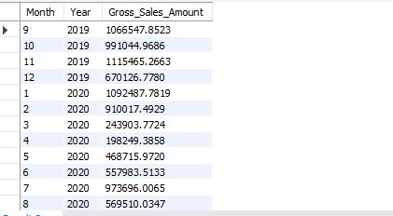
7. Get the complete report of the Gross sales amount for the customer “Atliq Exclusive” for each month. This analysis helps to get an idea of low and high-performing months and take strategic decisions. The final report contains these columns: Month , Year , Gross sales Amount.
Insights:
Identifies monthly sales performance trends for strategic decision-making.
Highlights peak and low-performing months, informing resource allocation.
Assists in evaluating the effectiveness of marketing campaigns over time.
Provides data for financial forecasting and budget adjustments.
Aids in identifying seasonality effects on sales, supporting inventory management.

Slide 9
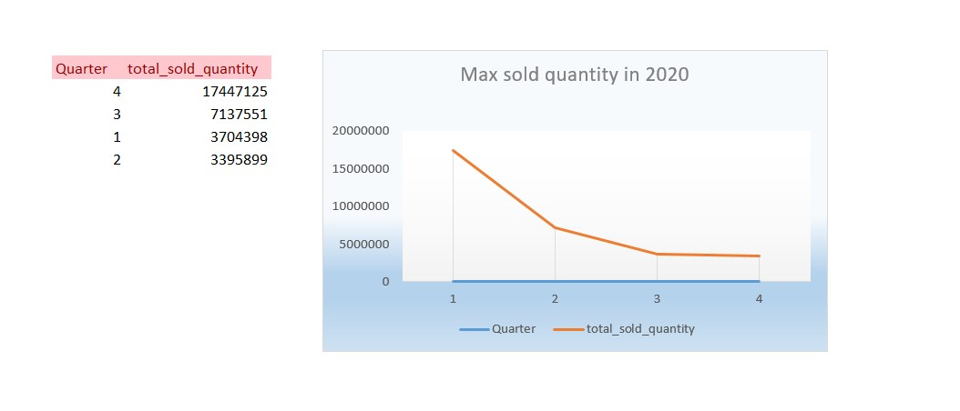
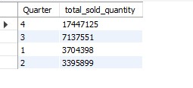
8. In which quarter of 2020, got the maximum total_sold_quantity? The final output contains these fields sorted by the total_sold_quantity, Quarter total_sold_quantity.
Insights
Identifies the quarter with the highest sales volume, indicating peak demand periods.
Assesses seasonal trends and their impact on sales performance.
Informs strategic planning for inventory and resource management.
Provides insights for future sales forecasting and goal setting.
Aids in evaluating the effectiveness of promotional campaigns during specific quarters.

Slide 10
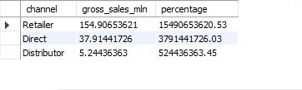
9. Which channel helped to bring more gross sales in the fiscal year 2021 and the percentage of contribution? The final output contains these fields, channel gross_sales_mln percentage.
Insights on Sales Contribution by Channel in Fiscal Year 2021
Identifies the most effective sales channel, guiding resource allocation.
Highlights contribution percentages, revealing channel effectiveness.
Assesses the impact of marketing strategies on channel performance.
Informs decisions for future channel investments and development.
Supports comparative analysis against other channels for optimization.

Slide 11
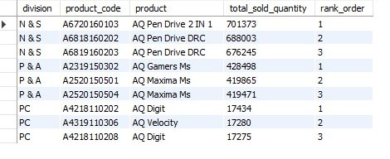
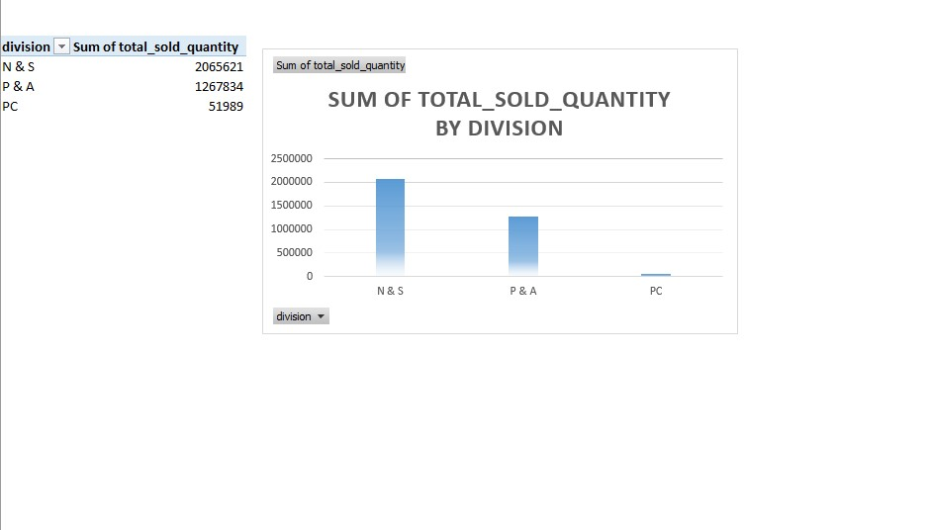
10. Get the Top 3 products in each division that have a high total_sold_quantity in the fiscal_year 2021? The final output contains these fields, division product_code ,product total_sold_quantity rank_order.
Insights on Top Products by Division in Fiscal Year 2021
Identifies leading products within each division, highlighting market leaders.
Assesses product performance, informing inventory and production planning.
Provides insights for targeted marketing strategies based on top-selling products.
Aids in evaluating product competitiveness within divisions.
Supports strategic decisions for product development and enhancements.

